Slide 1


2025
SHORT DECK

Slide 2
CRITICAL INFRASTRUCTURE PROBLEMS WE SOLVE.
Urban Logistic Advisory Services Inc., (“ULAS” or “Companies”) is a Texas State corporation investment vehicle and an associate company to Continental Advisory Services (“CAS”), LLC,
a family office. ULAS and CAS were incorporated in NYC in 2016 and 2002, respectively.
ENERGY
AEROSPACE
Lithium-Ion mobile power solutions
Airframe, Powerplant, Avionics,
Logistical solutions
ENGINEERING
TECHNOLOGY, MEDIA & TELECOM
Patented sustainable design, Manufacturing,
Mechanical, Electrical, and Plumbing solutions
Patented OEM semiconductor, O&M data centers, Operational Technology, Cyber Risk Mitigation and Broadband

Slide 3

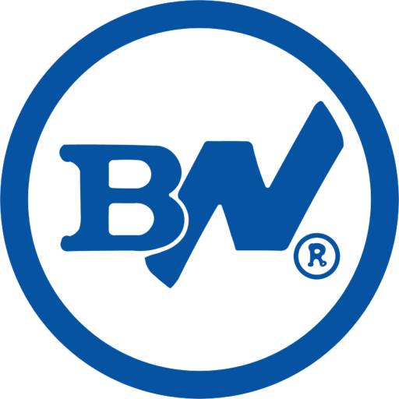
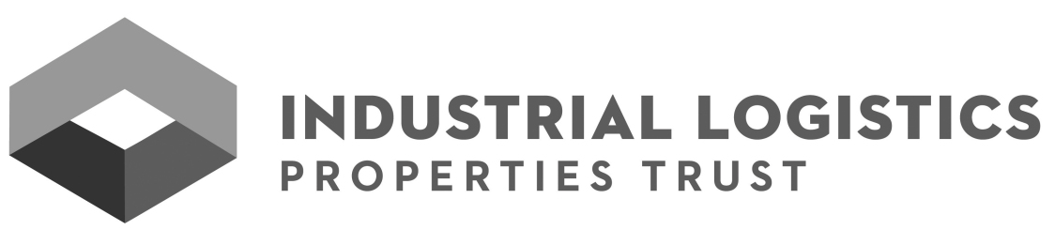
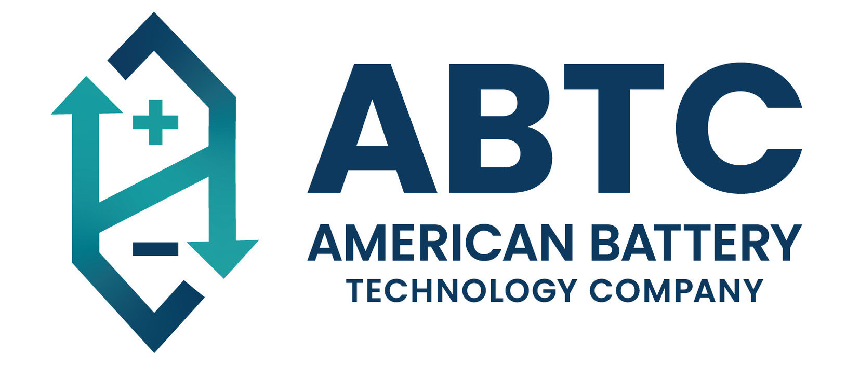
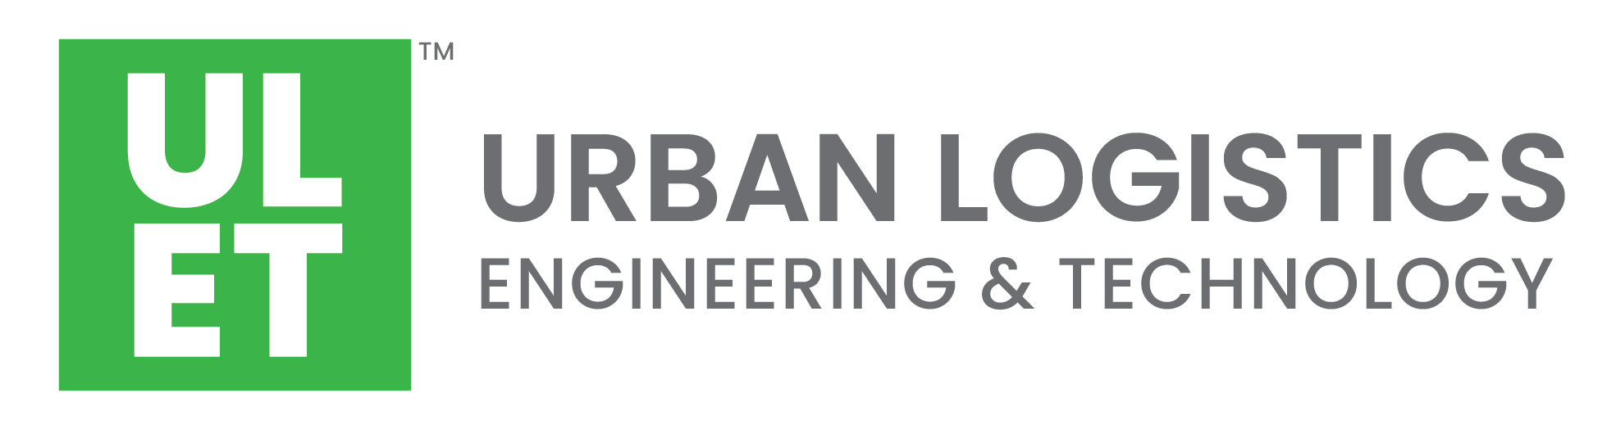

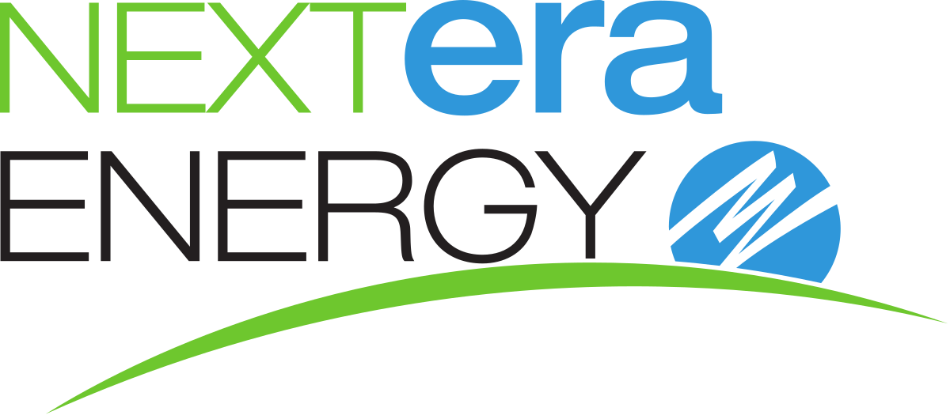

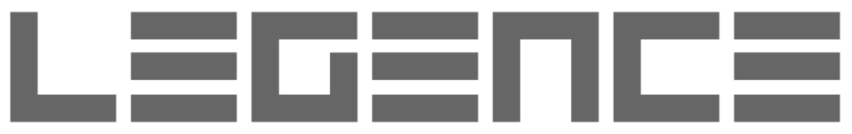

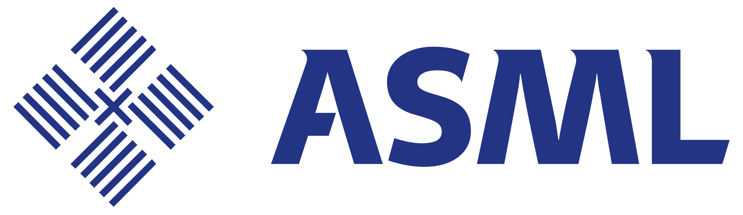

PORTFOLIO: OPERATING COMPANIES
AEROSPACE & LOGISTICS
ENERGY
ENGINEERING
TECHNOLOGY, MEDIA & TELECOM
3
STRICTLY PRIVATE & CONFIDENTIAL 2023

Slide 4

BUTLER NATIONAL
Butler National (OTCMKTS: BUK) is a leader in the growing global market for specialized aircraft structural modification, maintenance, repair and overhaul (MRO), and a recognized provider of gaming management services.
Butler National operates two Federal Aviation Administration ("FAA") Repair Stations, concentrates on enhancements to Learjet, Beechcraft King Air, Cessna Caravan, Gulfstream, and other turbine powered aircraft, and designs and manufactures robust electronic controls and cabling.
STRICTLY PRIVATE & CONFIDENTIAL 2023

Slide 5

AAR (NYSE: AIR) is an independent provider of aviation services to commercial and government customers around the world. The Company was founded in 1955 and today has revenues of approximately $1.8 billion with employees supporting operations in over 20 countries. AAR’s award-winning Market Solutions include Parts Supply, MRO Services, Integrated Solutions, and Mobility Systems.
Each solution can be integrated or leveraged separately to help customers increase efficiency and reduce costs while maintaining high levels of quality, service, and safety. AAR is a trusted partner to airlines, militaries, and OEMs, delivering competitiveness so they can focus on safely transporting passengers, cargo, and parts around the world.
STRICTLY PRIVATE & CONFIDENTIAL 2023

Slide 6
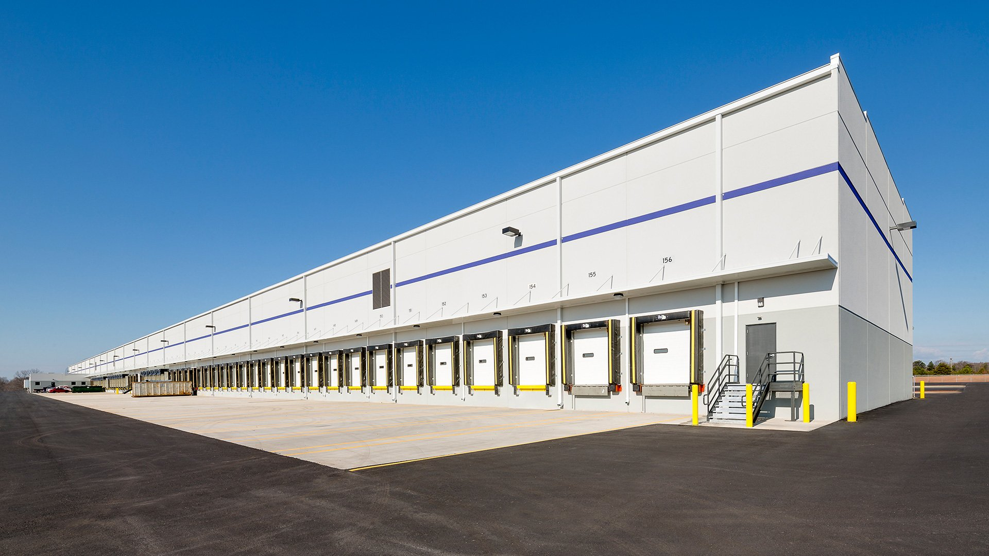
ILPT (NASDAQ: ILPT) is a leading real estate investment trust specializing in owning and managing industrial properties. With a portfolio of high-quality distribution centers, warehouses, and other industrial facilities located in key logistics markets across the United States, ILPT's properties are leased to a diverse group of tenants, including
e-commerce companies, third-party logistics providers, and manufacturers.
As of March 31, 2024, ILPT's portfolio consisted of 411 properties containing approximately 59.9 million rentable square feet located in 39 states.
STRICTLY PRIVATE & CONFIDENTIAL 2023

Slide 7


American Battery Technology Company provides technical development and commercialization of domestic, sustainable sourcing of critical battery materials through lithium-ion battery recycling and battery metal extraction technologies for use in batteries that power electric cars, grid storage applications, and consumer electronics and tools.
American Battery Technology Company initially started as a company with a few mining claims in Nevada and over the last few years, now with a new team and management, has grown to become an integrated battery materials company. Through our innovative, first-of-kind processing technology, we are uniquely positioned to supply low-cost, low-environmental impact, and domestically sourced battery metals through our three core operations to support a sustainable closed-loop battery metal economy. We recycle lithium-ion batteries back to cathode-grade material, are committed to sustainability, and are developing primary lithium resources in Nevada.
STRICTLY PRIVATE & CONFIDENTIAL 2023

Slide 8

NextEra Energy, Inc. is an American energy company with about 58 GW of generating capacity revenues of over $18 billion in 2020, and about 14,900 employees throughout the US and Canada.
It is the world's largest electric utility holding company by market capitalization, with a valuation of over $170 billion as of Oct 2024. Its subsidiaries include Florida Power & Light (FPL), NextEra Energy Resources (NEER), NextEra Energy Partners, Gulf Power Company, and NextEra Energy Services.

Slide 9


Lehr Engineering, established in 1969, is an internationally known consulting mechanical-electrical engineering firm has successfully completed projects on six Continents. Lehr is well-known for its innovation and successful application of leading technology on a wide variety of project types.
Lehr‘s success is founded on understanding client requirements and then acting in a fiduciary capacity as the technical extension of the clients will, in developing cost-effective integrated solutions.
Innovation is key to our engineering approach and is enhanced by active participation in numerous professional associations, an internal research and development subsidiary, and an international reputation for innovation evidenced by numerous published articles and keynote presentations.
STRICTLY PRIVATE & CONFIDENTIAL 2023

Slide 10
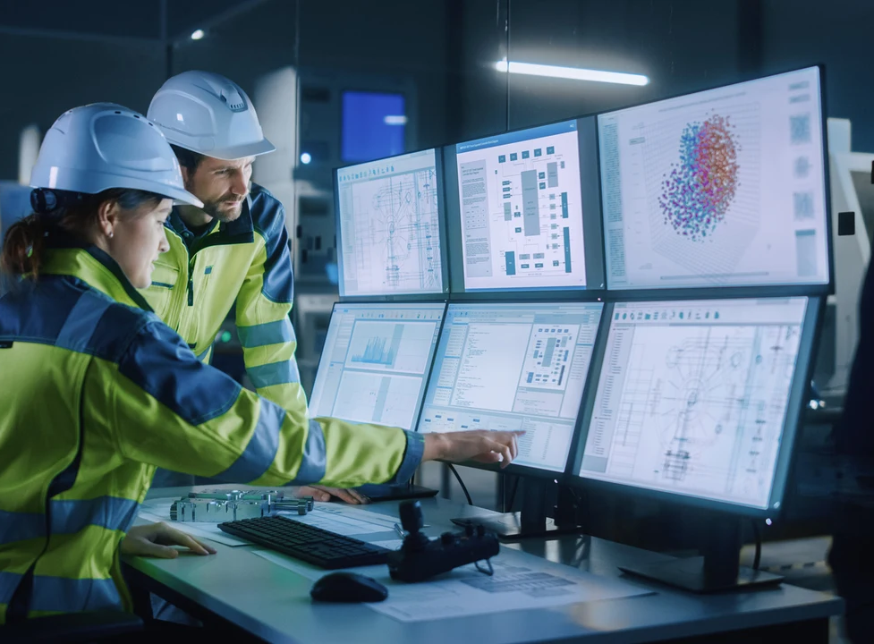
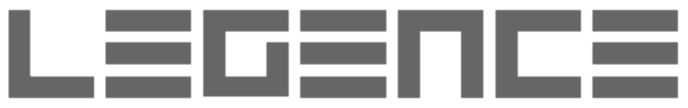
Legence Corp is a provider of engineering, installation and maintenance services for mission-critical systems in buildings. It focuses on high-growth sectors that have technically demanding buildings, including technology, life sciences, healthcare and education. The company specializes in designing, fabricating and installing complex HVAC, process piping and other mechanical, electrical and plumbing (MEP) systems for new facilities and upgrading HVAC, lighting and building controls in existing facilities to make them more energy efficient and sustainable.

Slide 11
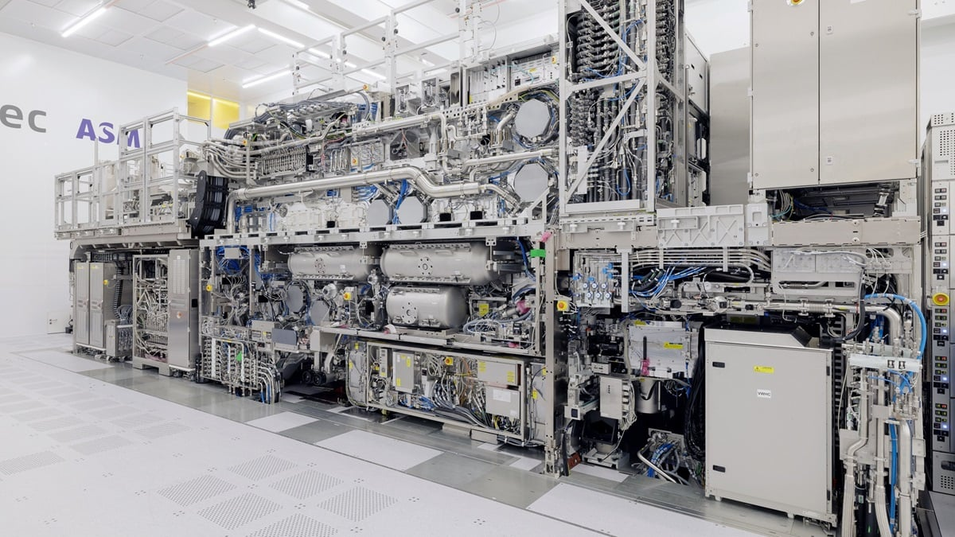
ASML Holding (NASDAQ: ASML) is a Dutch multinational corporation that designs and manufactures lithography systems, which are used in the semiconductor industry to make integrated circuits. It is one of the world's leading suppliers of such systems.
Lithography Systems: ASML's core business is producing photolithography systems, essential for creating the intricate patterns on semiconductor chips.
Industry Leader: The company is a major player in the global semiconductor equipment market.
Global Presence: ASML has a worldwide customer base and a network of service locations in 16 countries.
Stock Exchange Listings: ASML is listed on the Euronext Amsterdam and Nasdaq stock exchanges.
Founded: ASML was founded in 1984 as a joint venture between Philips and ASM International and became a fully independent corporation in 1995.
Main Clients: ASML's major clients include TSMC, Samsung, and Intel.

Slide 12
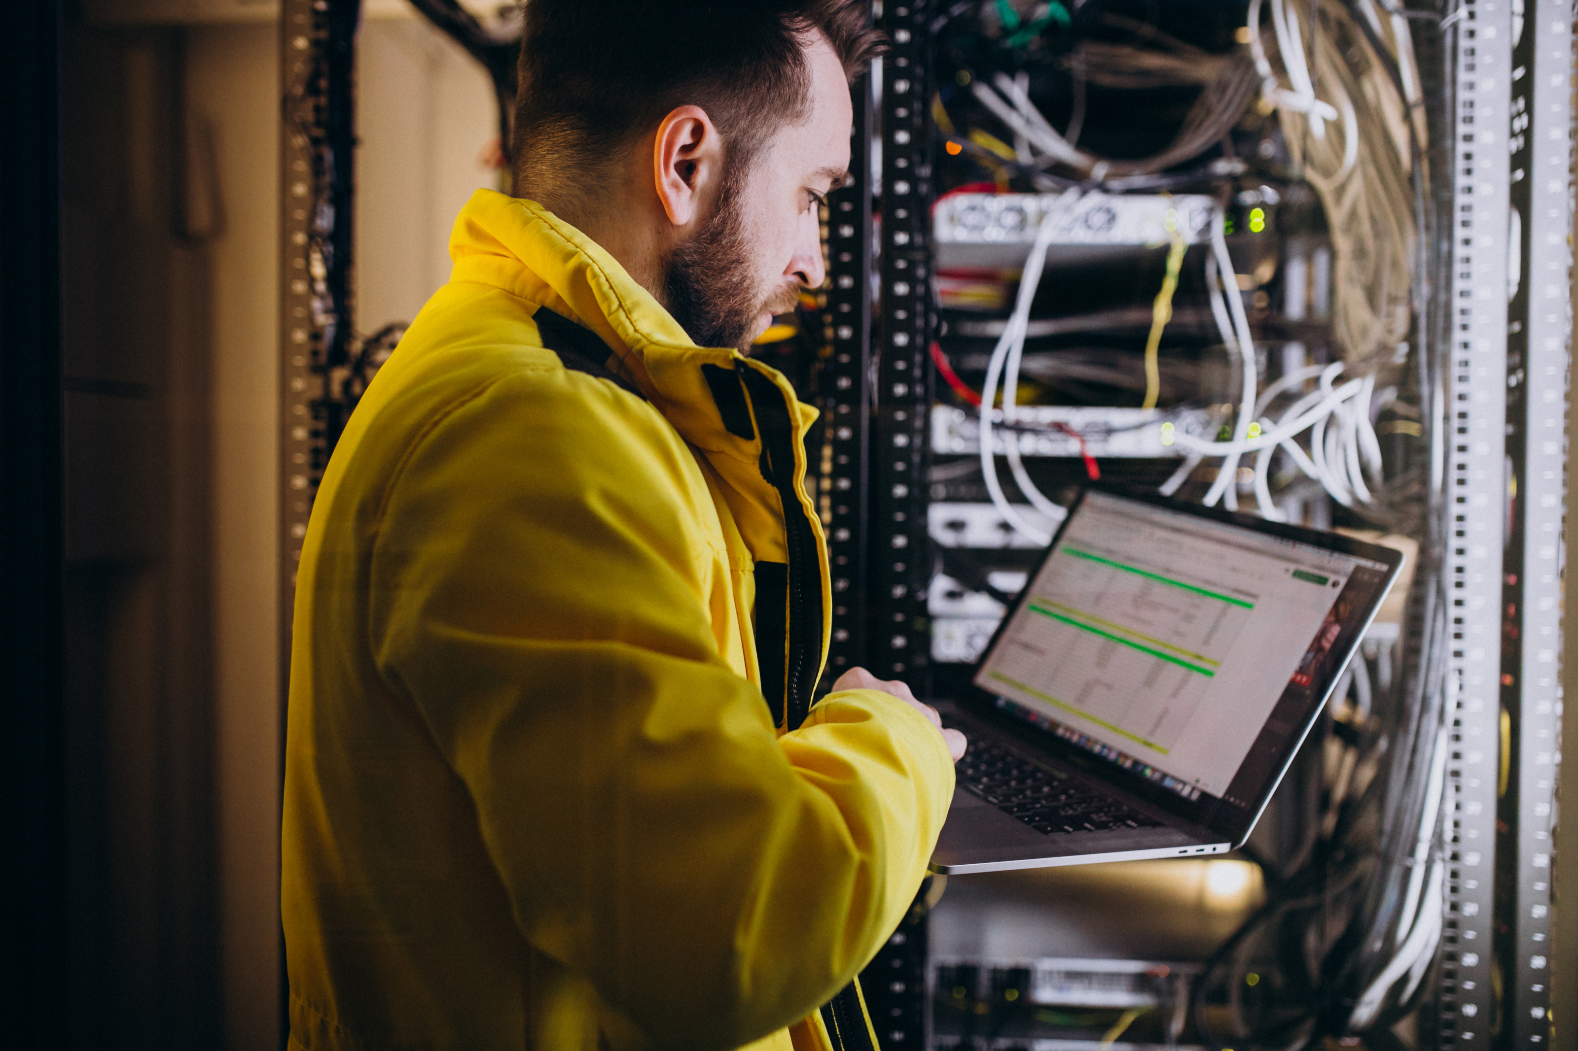

Broad reach into key markets
We are headquartered in the Northeast with key partnerships in place that extend our colocation, managed and cloud services into key national and international markets.
Enterprise-scale hybrid solutions
NYI offers a comprehensive portfolio of custom hybrid IT solutions including colocation, cloud, bare metal, and disaster recovery, along with a full suite of professional and managed services built over a robust network that provides extensive reach and diversity, everything you’d expect from a cutting-edge solutions provider.
Extensive cross-industry experience
Our customers are leaders in media and publishing, financial services and fashion, law and real estate, technology and life sciences. We’ll be the first to say that we built our reputation on their success.
Deep expertise, integrity and world-class service
In addition to providing enterprise-scale reliability, our solutions come with a level of service and commitment that is unmatched in the industry. Our experts work closely with clients to assess, plan, design, deploy and manage highly optimized, cost-effective solutions that meet and exceed business objectives.
Highly reliable redundant network
NYI’s fully meshed, BGP4-based, fault tolerant network is designed to have no single point of failure and offers the high capacity and zero- latency excellence you are looking for. In addition, as an NYI client, you will automatically have access to a premium Managed Network service that provides cross-connects to multiple network service providers.
12
STRICTLY PRIVATE & CONFIDENTIAL 2023

Slide 13
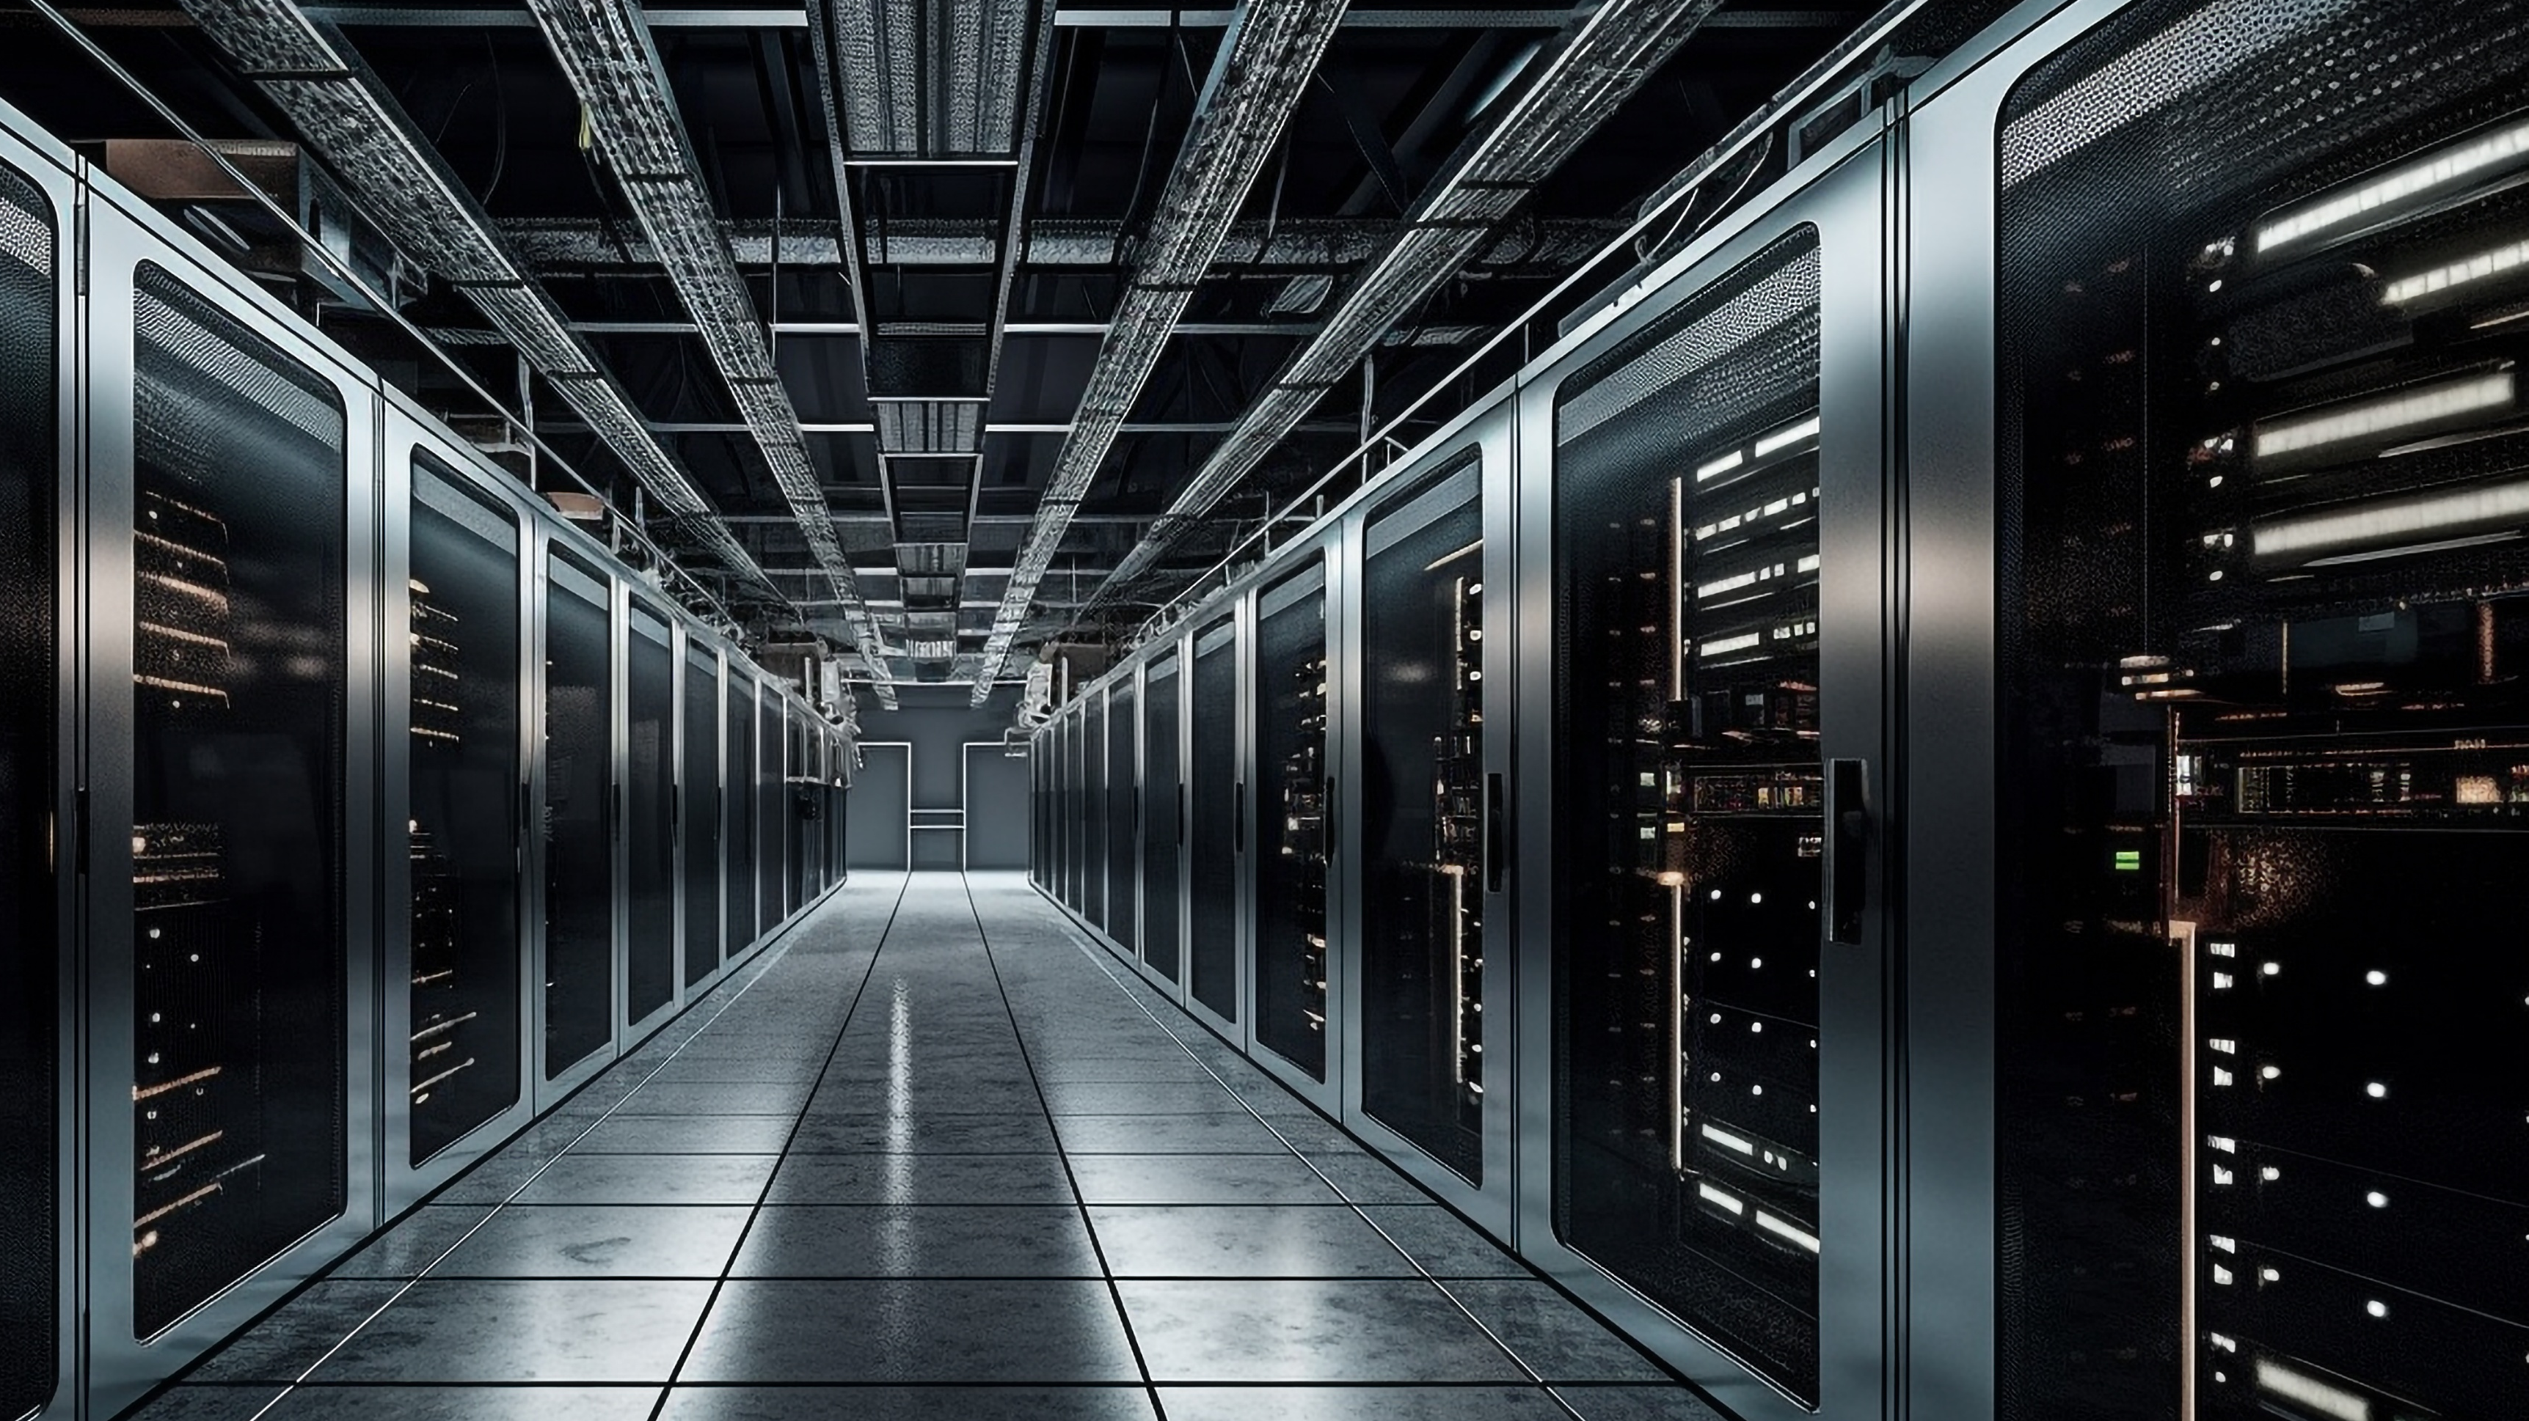

Digital Realty is a real estate investment trust that owns, operates and invests in carrier-neutral data centers across the world. The company offers data center, colocation, and interconnection services.
As of June 2023, Digital Realty has more than 300 facilities in more than 25 countries.
The company has made promises and efforts to reduce its carbon emissions. In 2020, Digital Realty joined the Science-Based Target Initiative, promising to reduce its Scope 1 and 2 emissions by 68% and Scope 3 emissions by 24% between 2018 and 2030. The company is also a signatory of the Climate Neutral Data Center Pact, a self-regulatory initiative – drawn up with the European Data Center Association (EUDCA) and Cloud Infrastructure Services Provider in Europe (CISPE) – designed to make the industry climate-neutral by 2030. In July 2023, Digital Realty received a Certificate of Conformity, certifying its adherence to the Self-Regulatory Initiatives set out by the Pact in Europe.
Digital Realty is working to switch entirely to renewable power. Many of its U.S. and European data centers are powered by renewable energy. The company has 1 GW of wind and solar projects under contract in Texas, Illinois, North Carolina, Oregon, Arizona and Virginia and has installed 1.8 MW of solar panels in Kenya, Greece, Switzerland, and South Korea.

Slide 14
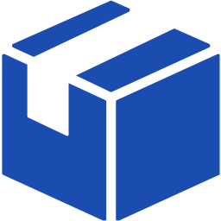




INTEGRATED ENGINEERING SOLUTIONS
Over 100,000 SKU's
Sectors: Energy, Aerospace, Logistics, Engineering, Technology, Media, Telecom and Saas
Five Countries: USA, Armenia, Denmark, South Korea
300+ Industrial/Engineering/ Tech Professionals
14
STRICTLY PRIVATE & CONFIDENTIAL 2023

Slide 15
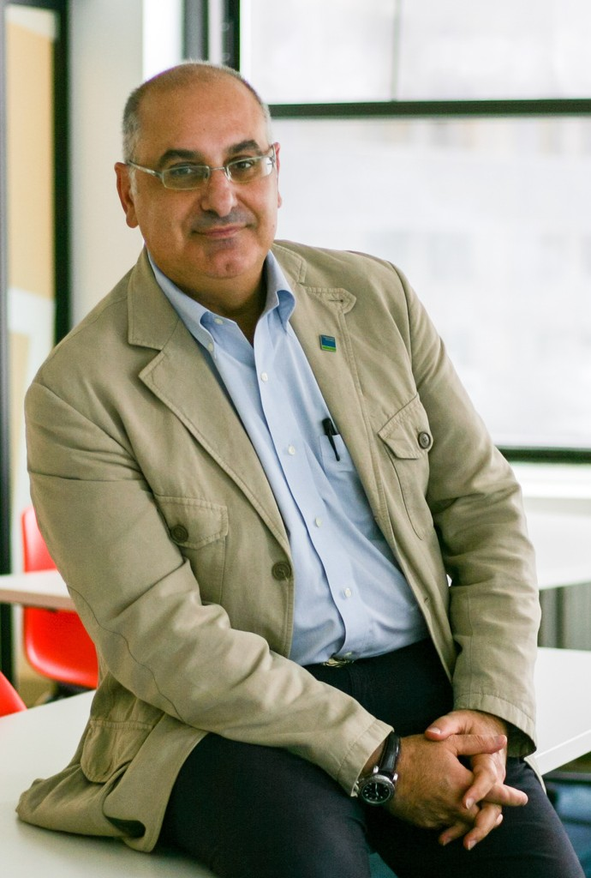

CONTACT
JACOB YAHIAYAN
Chief Executive Officer
Email: jyahiayan@ulasinc.com
1201 Fannin Street, Suite 262, Houston, Texas 77002
Phone: 646-384-2353
Mobile: 631.660.7052

